Slide 1
Proxy Demo
Laura Klions - lk876914
Chase King - ck240617
Nick Maude - nm346217
Jeffery Parker - jp344916

Slide 2
Updates
Working Sign in Screen
Only one possible login currently
Screen to Select Location
Currently only arc and dining halls
Potential to host other campus locations
Arc Traffic Screen
Shows all study rooms in the building
Users can mark if they are occupying a room so more data can be collected from users and improve predictions

Slide 3
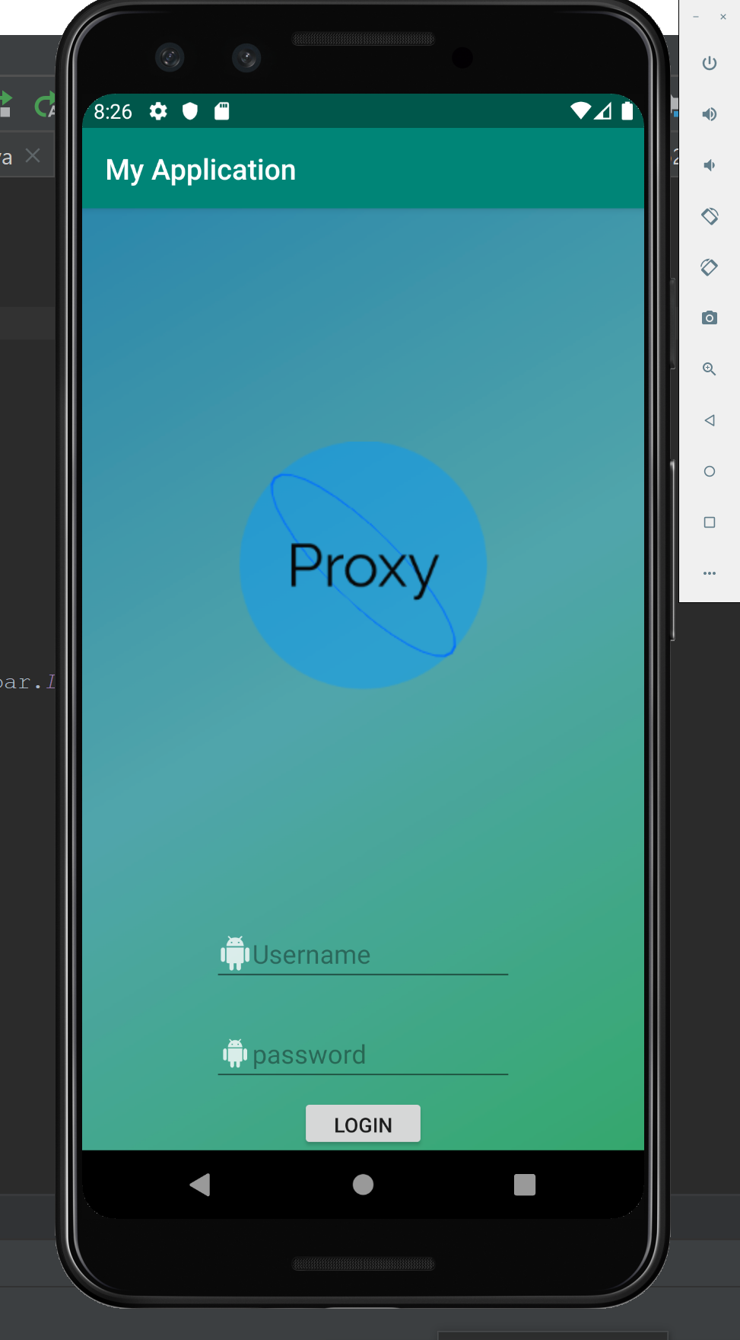
Login
Currently only one user,
Login: Admin
Password: Admin

Slide 4
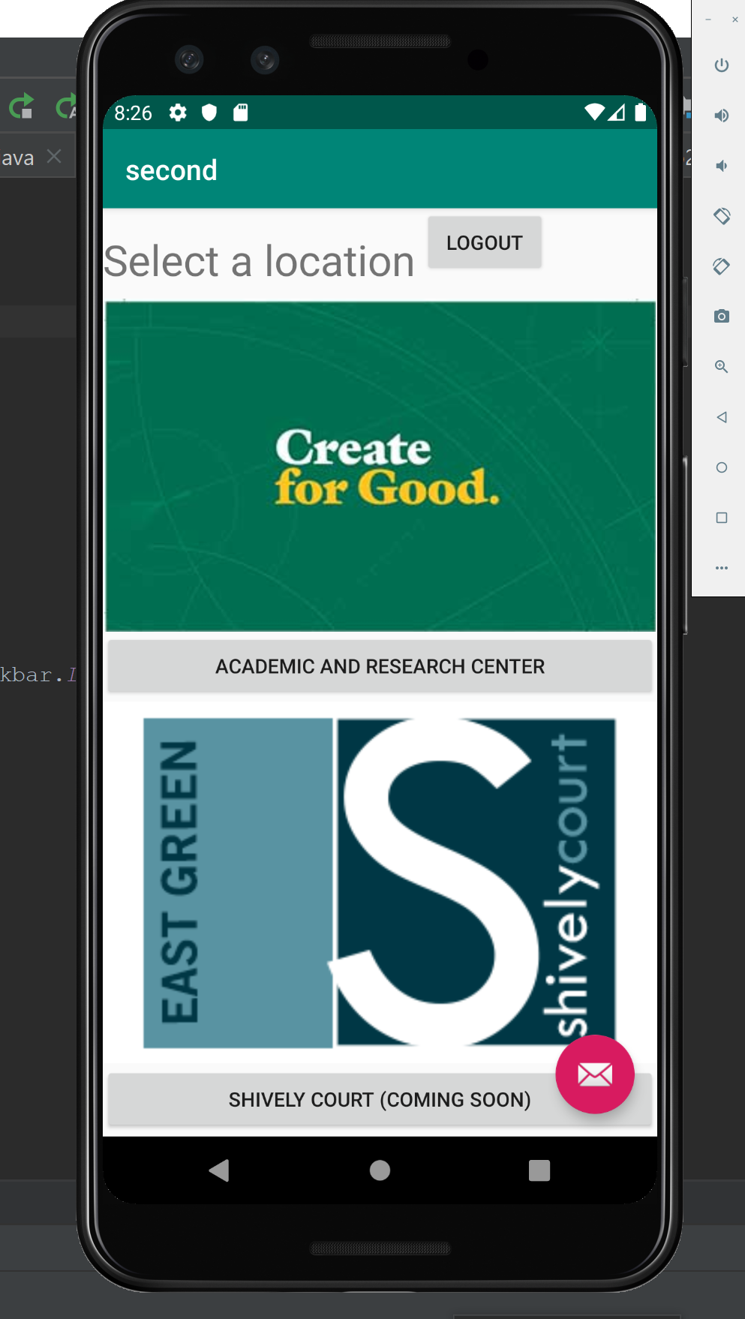
Location Selection
Links to page with summary of arc traffic
Other locations (Such as the dining halls will be implemented after success of Arc)

Slide 5
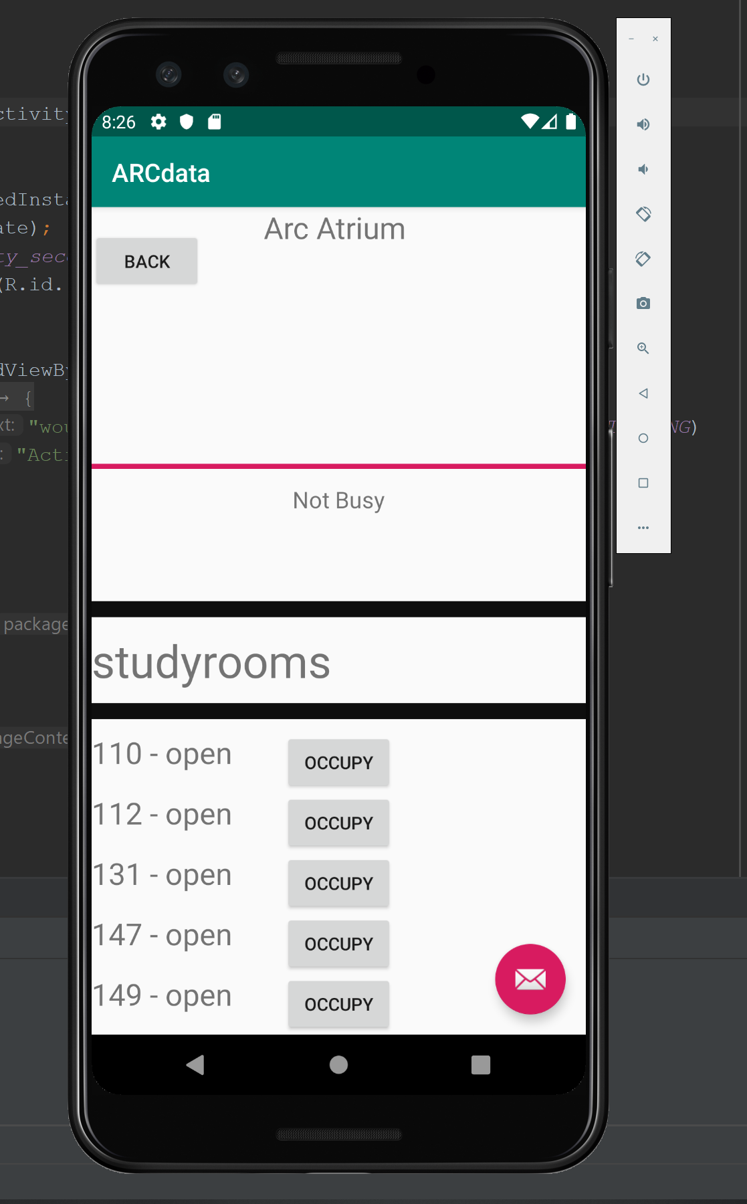
Arc Traffic
Quick Summary of Traffic
Full List of rooms, their availability, and button for user to input data [Occupy Room]

Slide 6


Upcoming
Fit GUI to other models of phones
Currently only Pixel 3
Decide how to host data to prevent compiling each time data points are added
Docker
AWS
Add ability to have multiple logins and passwords

